Slide 1
DIY weather station
Session 2 of 5
Cary area public library

Slide 2
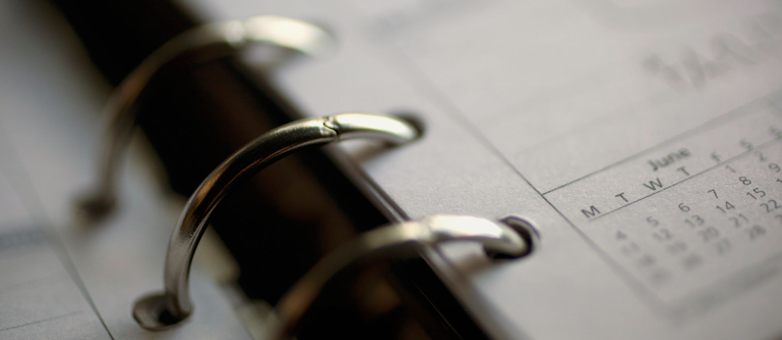
Session Agenda
Reading a Schematic
Wiring up the entire project on a Breadboard
Updating the NodeMCU Firmware
Installing the DIY Weather Station application
Configuring the Weather Station to work on the Library Wifi
Hooking the Weather Station up to ThingSpeak

Slide 3

Course plan
Day 1 – January 5th
Introduction
Safety Overview
How to Solder
Solder up BMP280
Day 2 – January 19th
Schematics
Breadboard wire up Test
Configure NodeMCU modules
Thingspeak accounts
Day 3 – February 2nd
How to solder review
Solder headers
Wire up PCB
Day 4 – February 16th
PCB Soldering
Day 5 – March 2nd
Final assembly and test
Review

Slide 4
Breadboards
Power and ground rows
Columns are connected
Two sides – Gap separated
Grid Layout
Can you Find C:19?

Slide 5
Parts List
51K resistor
Photoresistor
NodeMCU
USB Cable
BMP280 + Header
8 Male-Male Wires
Breadboard

Slide 6
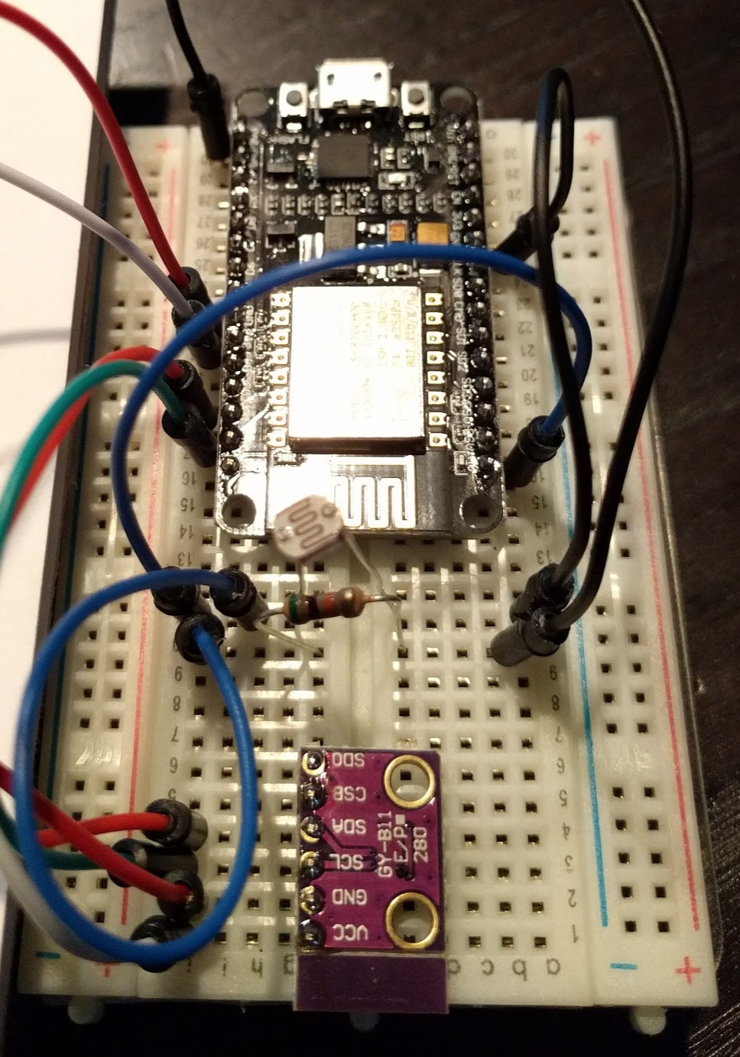
Wire up and TEst
Prepare the IDE
Add Library WiFi Configuration
Add Thingspeak Configuration
Add Blynk.cc Configuration
Build Firmware
Flash the NodeMCU
Veriy the Output
The ‘How To’ is on the Github Wiki

Slide 7
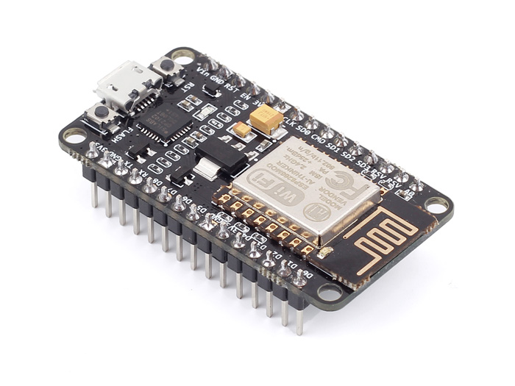
NodeMCU
ESP8266 - ESP-12E
Version 2
3.3V Based
1 Analog Pin
GPIO and PWMs
Input Voltage 5-10V

Slide 8

Voltage Division
V_{out} = (R₂ ÷ (R₁ + R₂)) * V_{in}

Slide 9
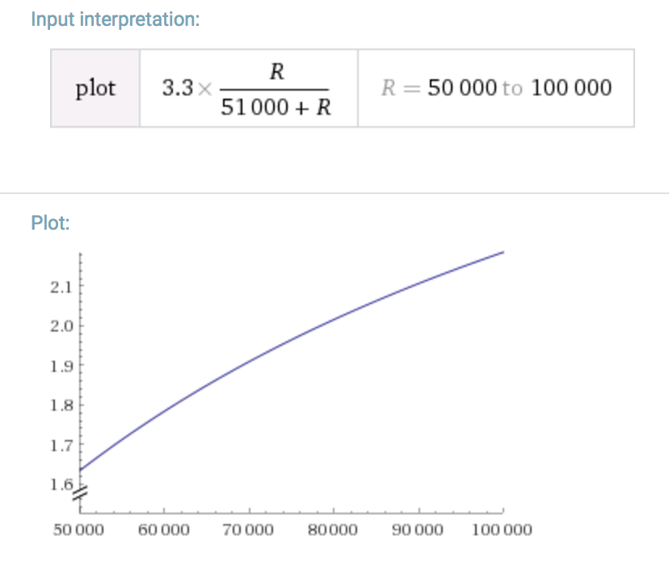
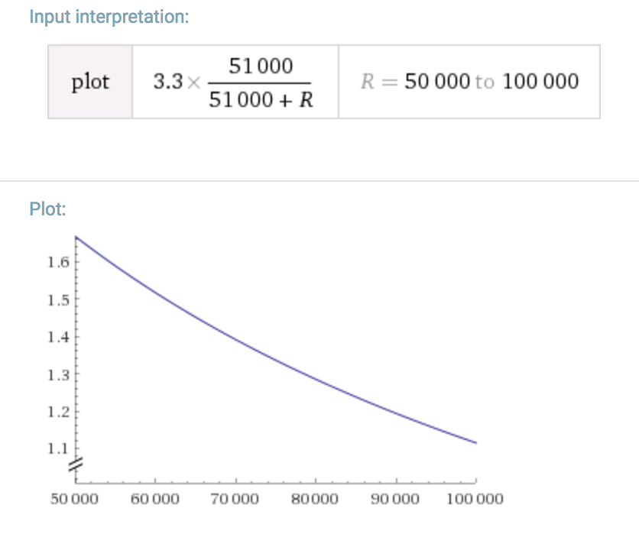
Typical Voltage Ranges

Slide 10
Next session
February 2nd – 5-6:30 pm
How to solder review
Solder headers
Wire up PCB

